Slide 1
Project – 250 Resume Classification
By Pradyumna PS

Slide 2

Resume Classification
Business Objective
The document classification solution should significantly reduce the manual human effort in the HRM. It should achieve a higher level of accuracy and automation with minimal human intervention.

Slide 3
Natural Language Processing (NLP) has gained popularity for multiple reasons and it is an exciting technology that is here to stay for a long time. NLP deals with machines understanding the way humans speak and write the language in their everyday lives. If this Artificial Intelligence (AI) subdomain grabs your attention, you can start with some textbook projects. In this article, I am going to go over one of the simple projects of that kind: classifying an applicant's resume.
The conventional techniques of hiring a candidate for a position is becoming more labor intensive, therefore inefficient, because of the growing online recruitment. The companies receive an excessive number of resumes in multiple categories for the vacant positions. Using some of the NLP and Machine Learning (ML) techniques, categorizing the applicants' resumes for the available positions can be automated. In this article, let's develop a simplified version of such a multiclass classification in Python using NLP. We will briefly go over the following steps:
1- Acquiring data
2- Cleaning/preprocessing/exploring text data
3- Vectorizing text data
4- Developing the ML algorithm
As a note, performance evaluation/comparison of the results will not be covered here since the main goal is to demonstrate basic NLP steps. Assuming you already have a Python environment, let's begin with importing pandas and matplotlib.

Slide 4
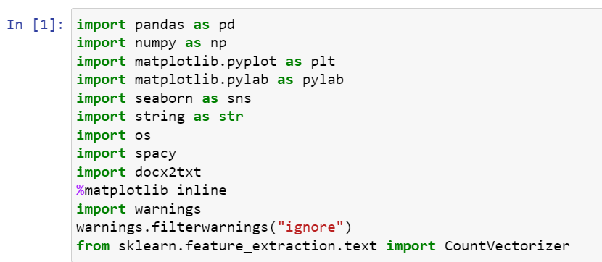
Importing libraries
The first step in an ML project is to import the required basic libraries.

Slide 5
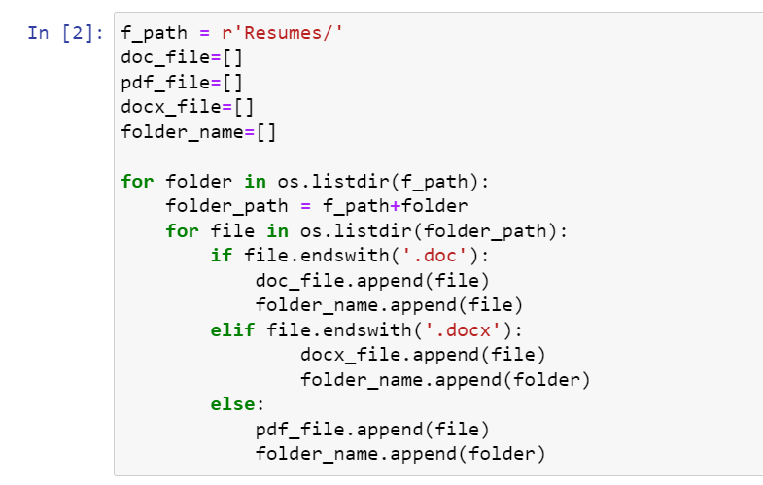
Extracting the data
The data is conveniently provided in the form of a .doc, .docx, .pdf file.

Slide 6
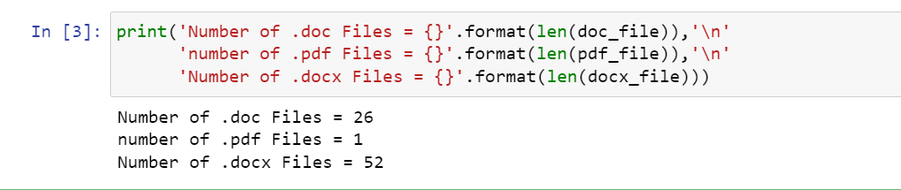
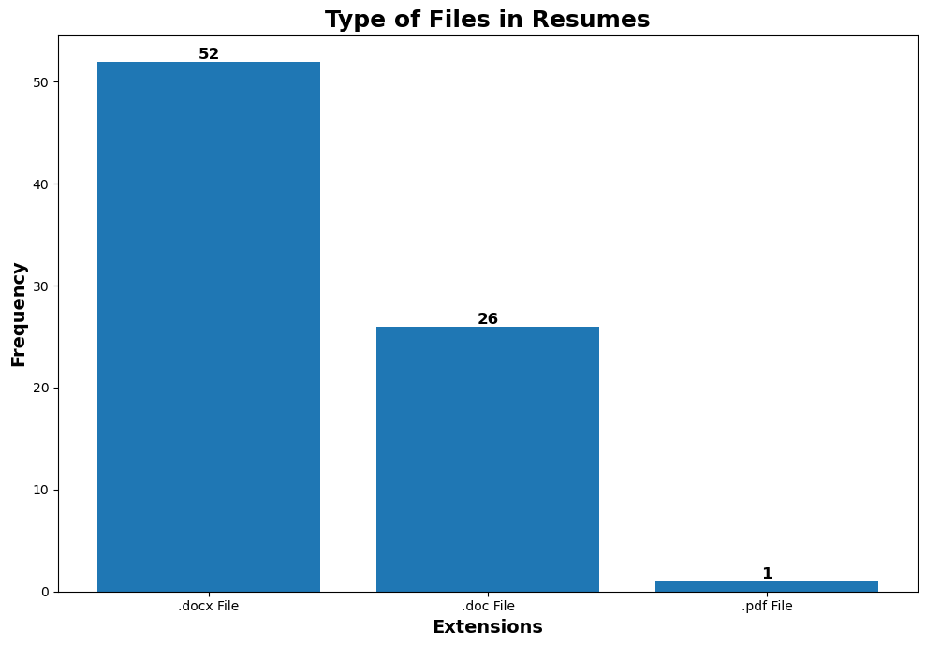
Visualisation

Slide 7
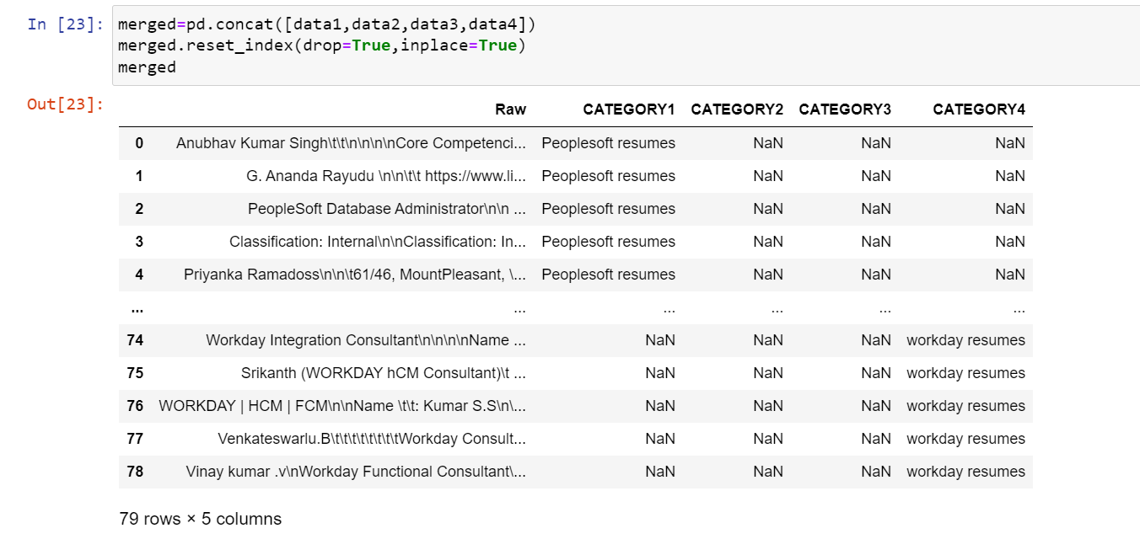
Exploring data
Resumes has been classified categorically and merged into one category.

Slide 8
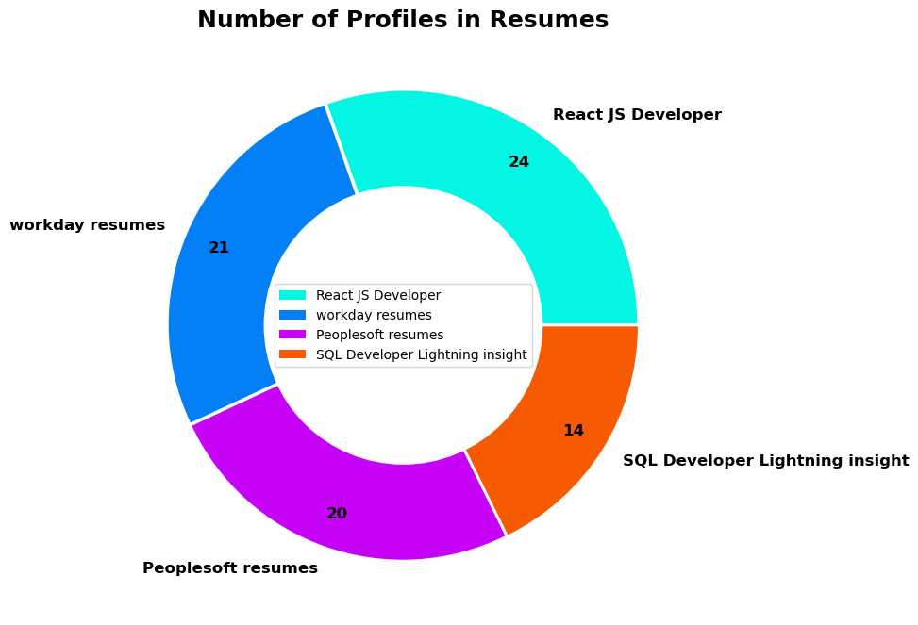
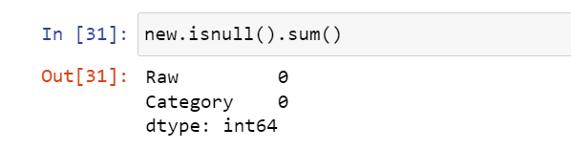
Visualisation & EDA
There are total of 80 resumes in the dataset. In which out of 4 different categories, React JS Developer class is the largest class with 24 resumes, whereas SQL Developer lightning insight class is the smallest with only 14 resumes.
To get information about non-null values and data type, we can rely on the info() method of pandas. We do not have any null values.

Slide 9
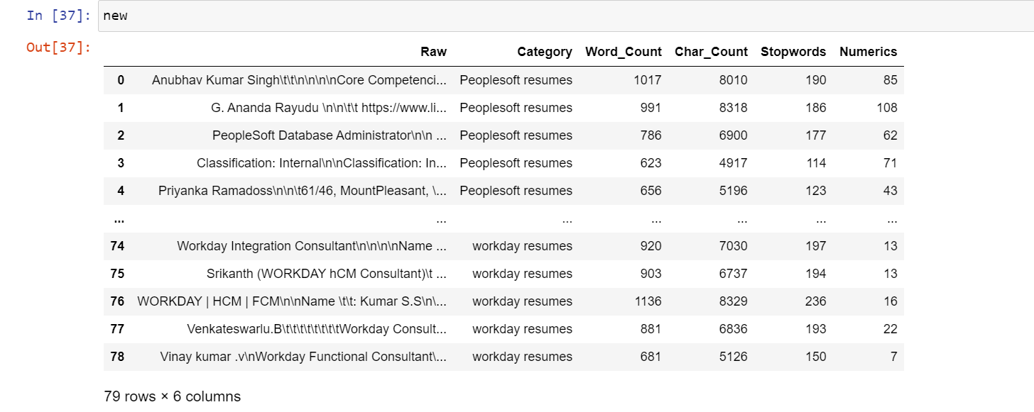
Text Preprocessing
Word count, character count, Stop words, Numerics has been calculated to each resume.

Slide 10
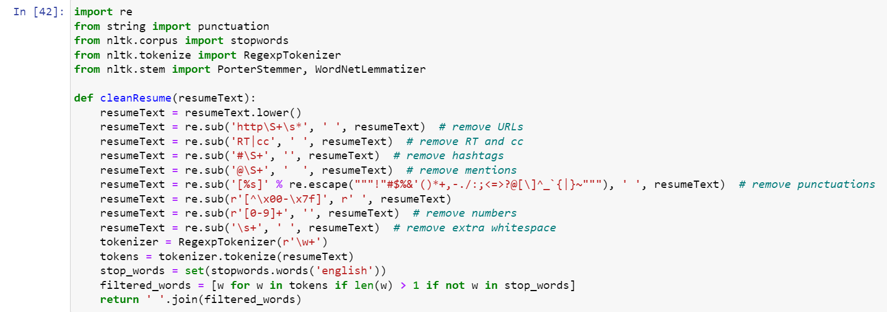
Text Preprocessing
There is a third party module in Python called re that handles regular expressions. In our cleanResume function, we are going to use mostly re.sub method to substitute a text with another, and re.escape to skip the punction marks so that we can eventually eliminate them from our text. We remove the punctuations, non-ascii characters, extra whitespaces and numbers in cleanResume function as a basic text cleaning for now. For normalization purposes, we are converting all letters to lowercase as well.

Slide 11
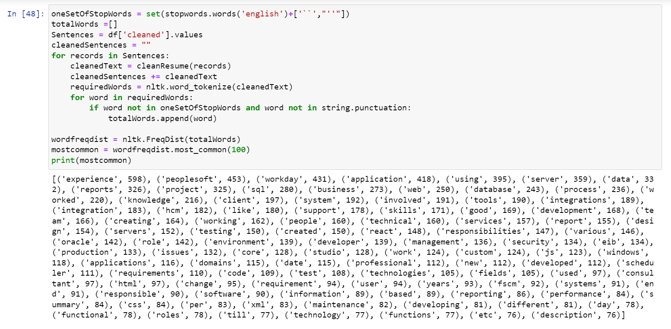
Finding common words
Text processing on a DataFrame column named 'cleaned'. It tokenizes the cleaned text, filters out stopwords and punctuation, and generates a frequency distribution of the remaining words. The code then retrieves the 100 most common words from the frequency distribution and prints them. However, it relies on a missing function called 'cleanResume' and a DataFrame called ‘df', which need to be defined or provided separately for the code to run properly.

Slide 12
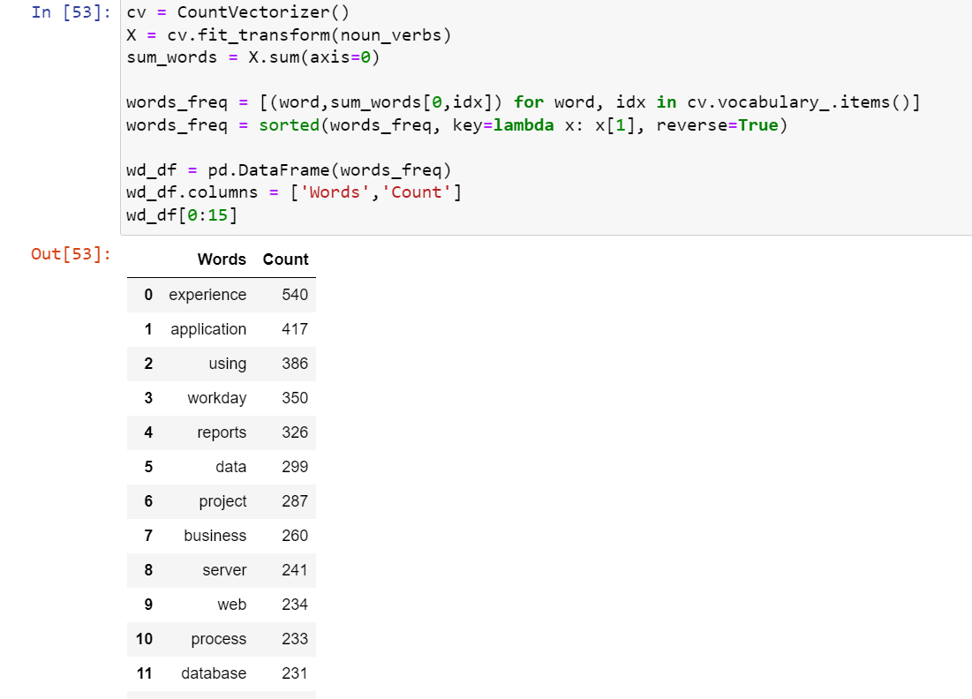
Count Vectorization
The CountVectorizer from scikit-learn to perform word frequency analysis on a dataset called 'noun_verbs'. It calculates the count of each word, sorts the results in descending order, and creates a DataFrame showing the 15 most frequent words along with their respective counts. This analysis helps identify the most commonly occurring words in the dataset.

Slide 13
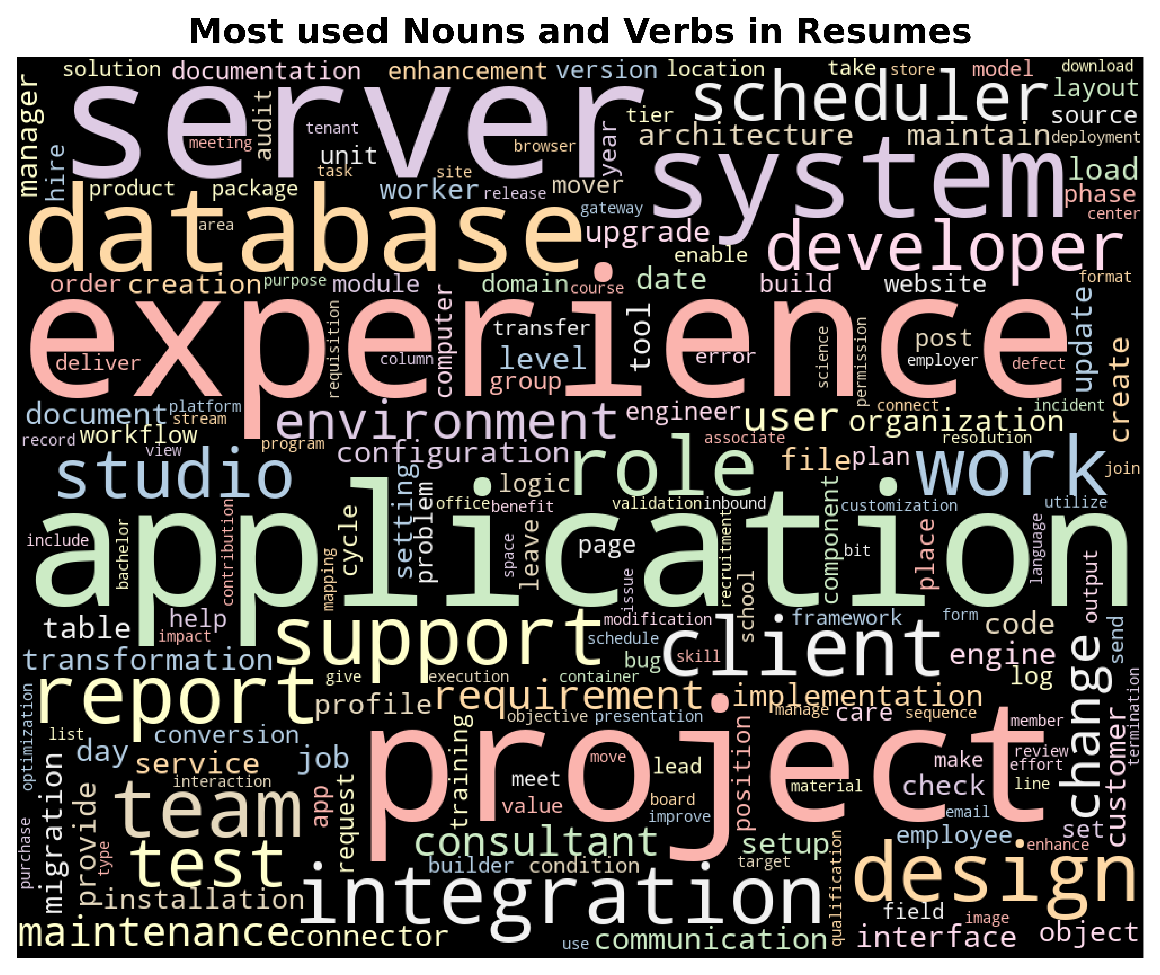
Word Cloud
In addition to word cloud, we can also see the frequency distribution of each word in the text, that is the number of times a word is used in total_words. FreqDist function is accessible from nltk library, and the total_words is fed into the function as an argument. The most frequent word is ‘Experience' with a word frequency of 540. During the data analysis phase, it is obvious that some of the words such as ‘application', ‘project', and ‘server' are not specific to the category.

Slide 14
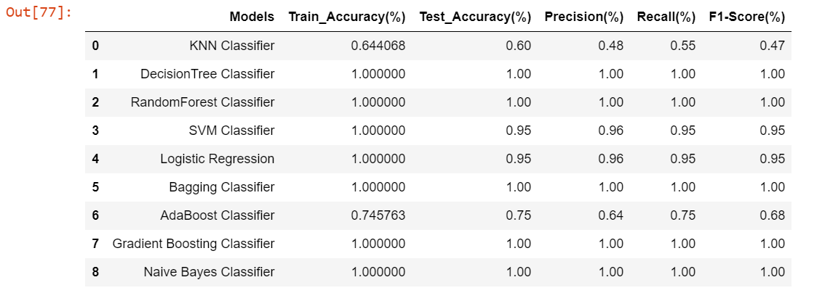
Model Selection
After data pre-processing, data has been split into train and test and vectorized to convert text documents into a matrix of TF-IDF (Term Frequency-Inverse Document Frequency) features. Vectorized data then passed through different models and respective F1 scores have been achieved.

Slide 15
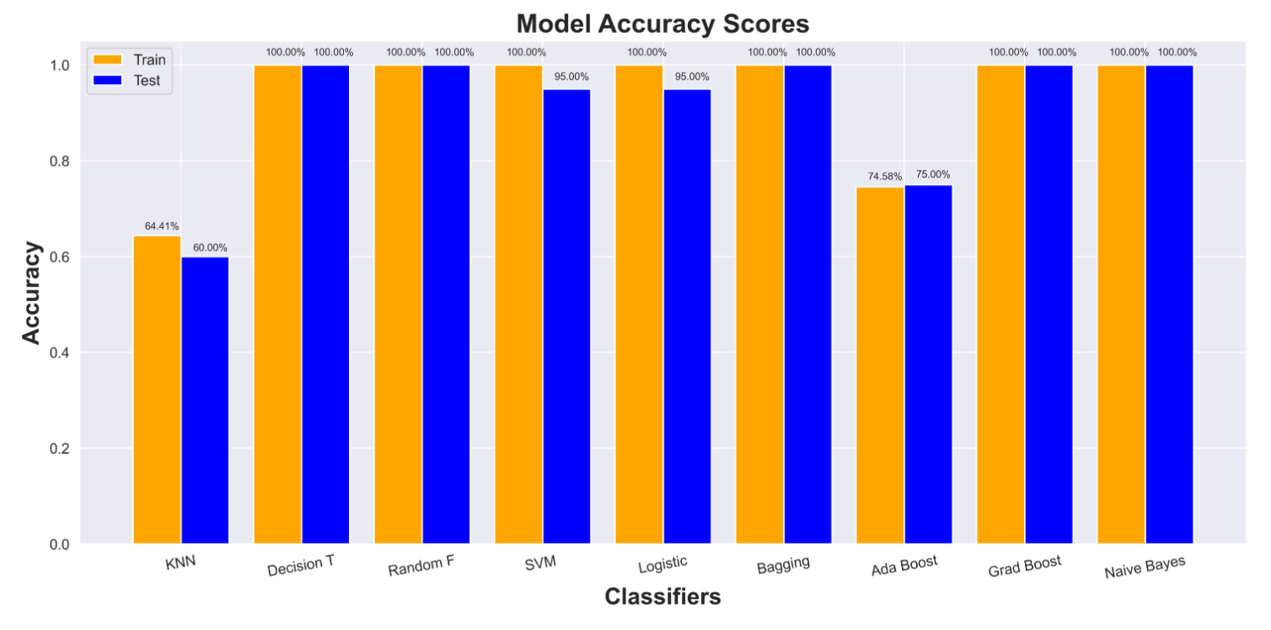
Train & Test accuracy plot

Slide 16
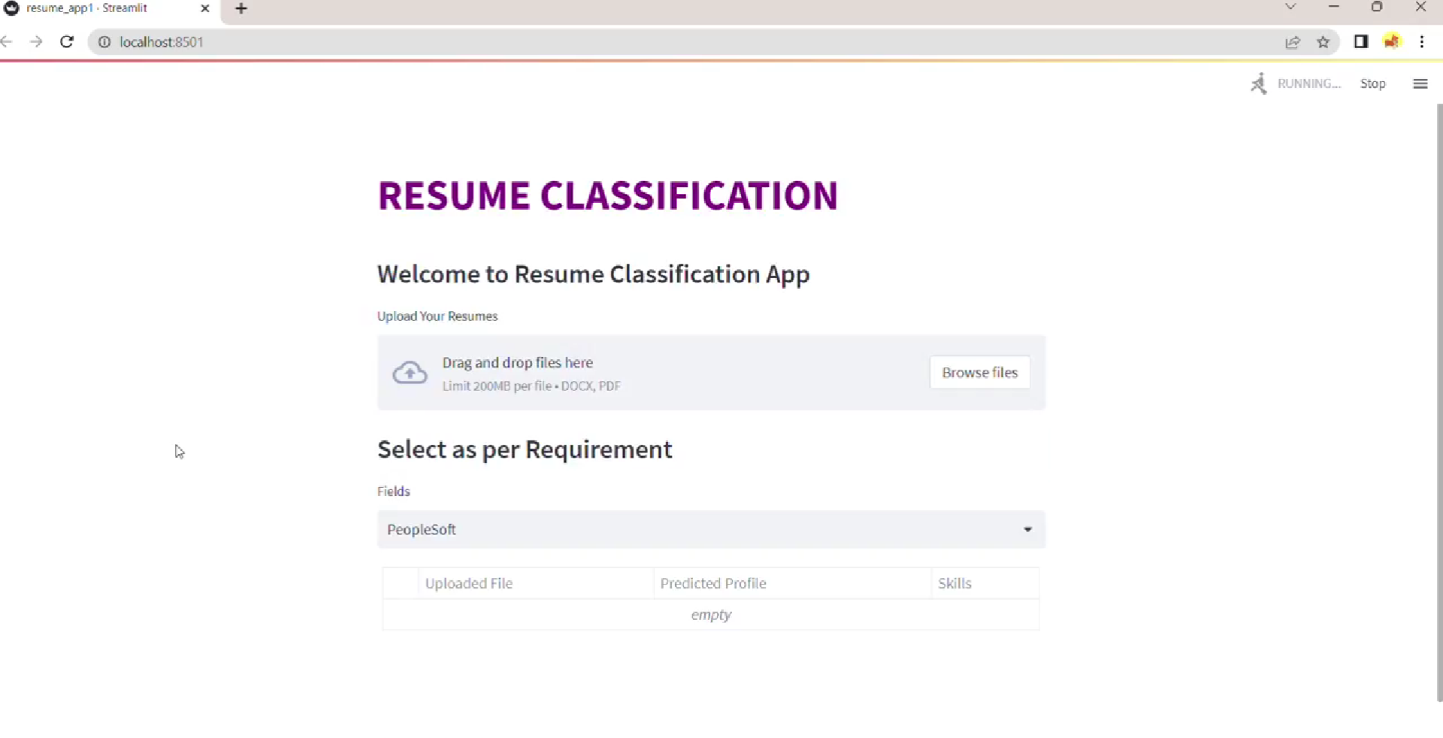
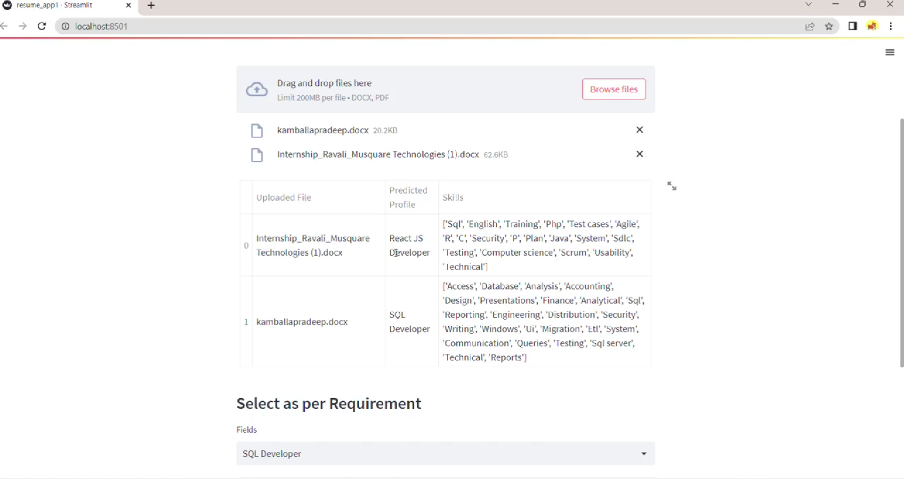
Deployment

Slide 17
THANK YOU

